Slide 1
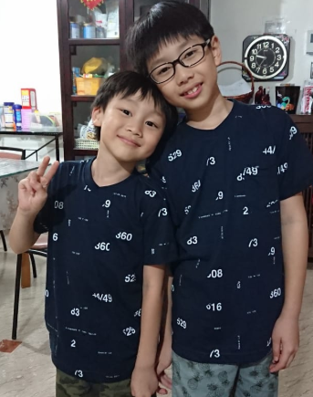

miSPICKy
Regina Cheong
27 Sep 2019

Slide 2
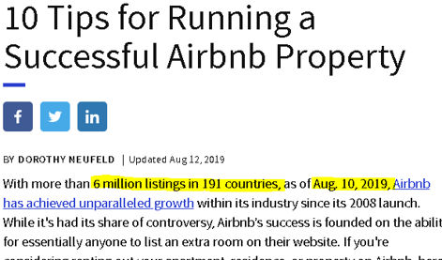

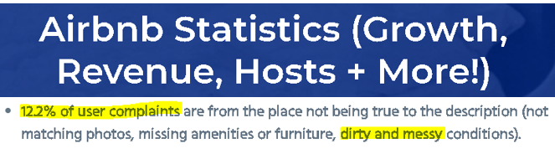
Multi-class Image Classifier
Clean / Tidy room
Messy room
Bad excuse

Slide 3
Process
Models Building
Front end Application
Web-scraping
Dataset Preparation
Model Testing

Slide 4
Web-Scraping
Clean Room
clean bedroom, tidy room, hotel room, clean and neat, declutter
Messy Room
clutter, mess, disorganized room
Bad Excuse
kids’ handwritten note, love letters, handwritten notes
etc..

Slide 5
Web-Scraping
Clean Room
clean bedroom, tidy room, hotel room, clean and neat, declutter
Messy Room
clutter, mess, disorganized room
Bad Excuse
kids’ handwritten note, love letters, handwritten notes
etc..

Slide 6
Web-Scraping
Clean Room
clean bedroom, tidy room, hotel room, clean and neat, declutter
Messy Room
clutter, mess, disorganized room
Bad Excuse
kids’ handwritten note, love letters, handwritten notes
etc..

Slide 7
Dataset Preparation
Models Building
Front end Application
Web-scraping
Dataset Preparation
Model Testing

Slide 8
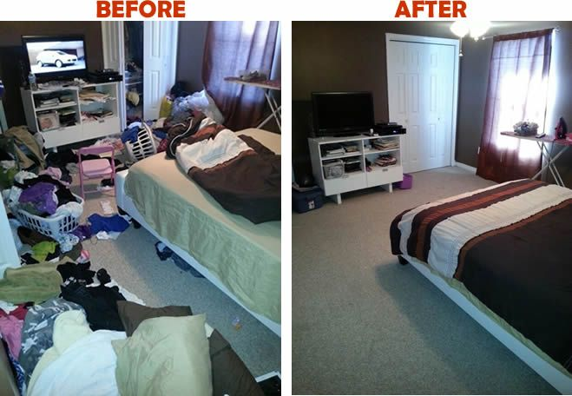
Dataset Preparation

Slide 9


Dataset Preparation

Slide 10
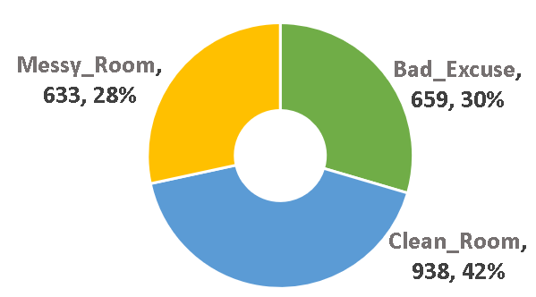
Dataset Preparation

Slide 11


Models Building
Models Building
Front end Application
Web-scraping
Dataset Preparation
Model Testing

Slide 12
Models Building
K-Nearest Neighbors
Gaussian Naive Bayes
Logistic Regression
Support Vector Classifier
Decision Tree
Multi-Layer Perceptron
Random Forest
XGBoost
Convolutional Neural Network (CNN)
0.76

Slide 13
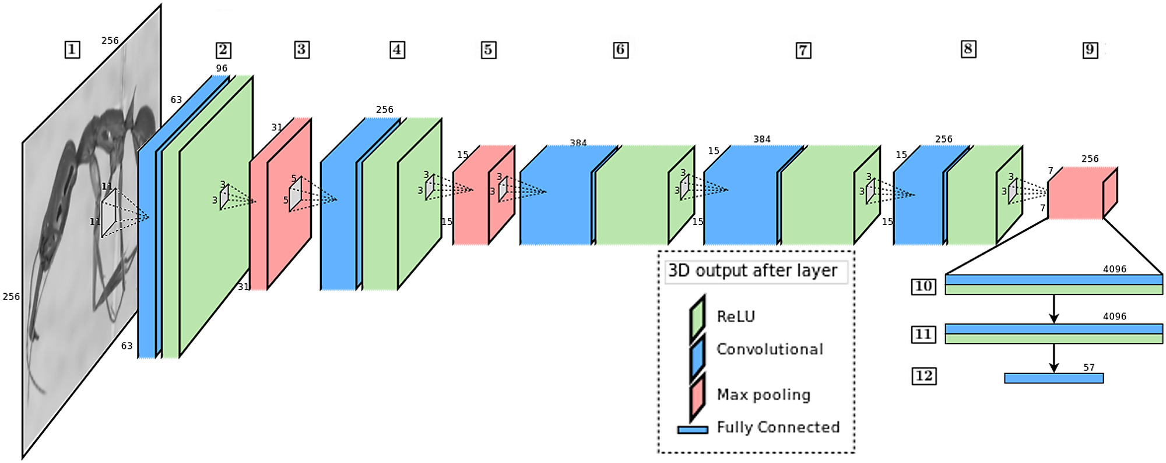
Models Building
Convolutional Neural Network (CNN) Architecture

Slide 14
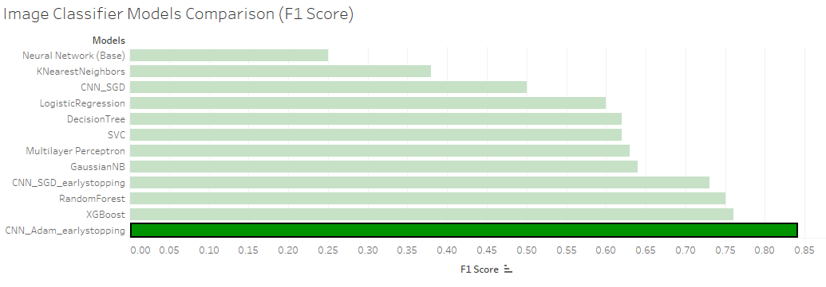
Models Building
CNN_Adam_earlystopping: 0.84

Slide 15
Model Testing
Models Building
Front end Application
Web-scraping
Dataset Preparation
Model Testing

Slide 16


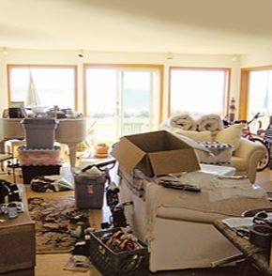
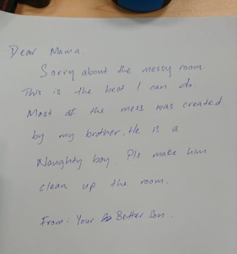
Model Testing
02
Clean Room
03
Messy Room
01
Bad Excuse
100.00%

Slide 17
Model Testing
65.75%
02
Clean Room
03
Messy Room
01
Bad Excuse

Slide 18
Model Testing
02
Clean Room
03
Messy Room
84.28%
01
Bad Excuse

Slide 19

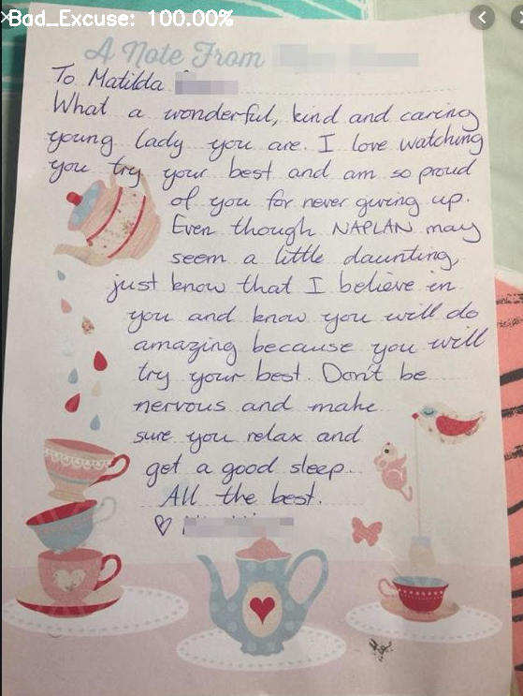
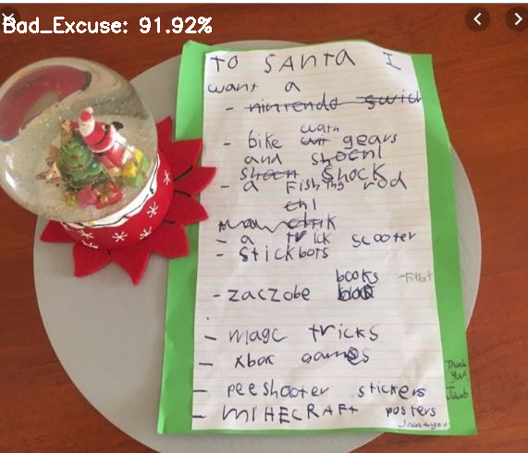
Model Testing
Meet Our Team
91.92%
Bad Excuse
Bad Excuse
100.00%

Slide 20
Front end Application
Models Building
Front end Application
Web-scraping
Dataset Preparation
Model Testing

Slide 21

Front-end Application
miSPICKy

Slide 22
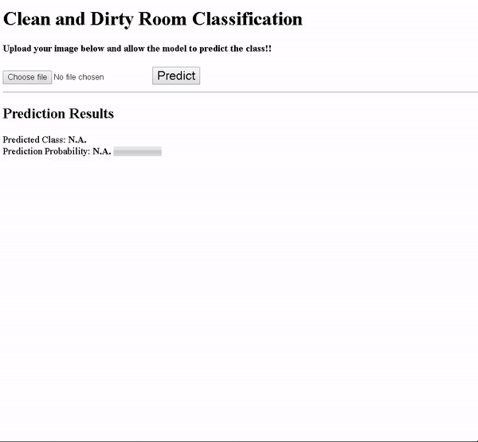

Slide 23
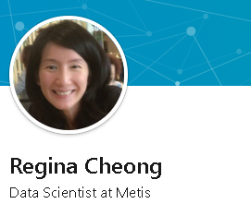





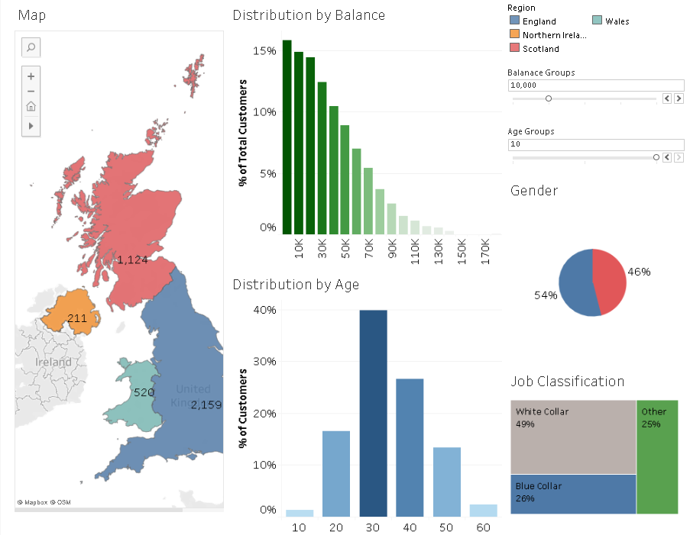
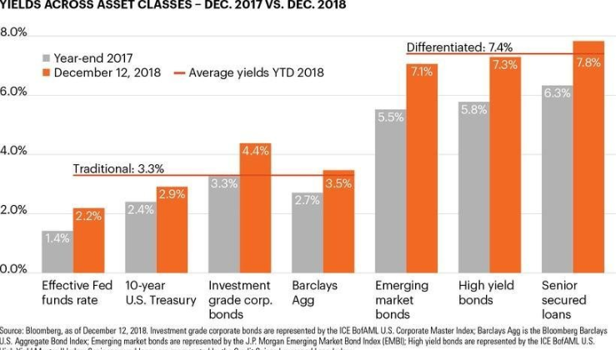

 | https://www.linkedin.com/in/regina-cheong
 | https://github.com/1Regina
 | https://public.tableau.com/profile/regina7068#!/
 | 1reginacheong@gmail.com
 | 98766330
Insights with Tableau
NLP Topic modelling & similarity scoring
Machine learning for investment decision
Regression models
Interactive dashboard on customer segmentation analysis
JD topics & resume matcher
Machine learning models to predict loan default
Regression models to predict rainfall

